Slide 1
Writing Across the Archives
Writing Across Emory
Dr. Sarah Harsh

Slide 2
Hello!
Dr. Sarah Harsh
Postdoctoral Fellow
Emory Writing Program
Rose Library Research Assistant

Slide 3
Overview of Presentation
2
1
3
4
Intro: Using Rose Library
Rationale
Resources
Why use archives in your class?
How to get started and find help for your archival work
Ideas
Examples
Possible class sessions and assignments
Archival classwork by Emory undergraduates

Slide 4
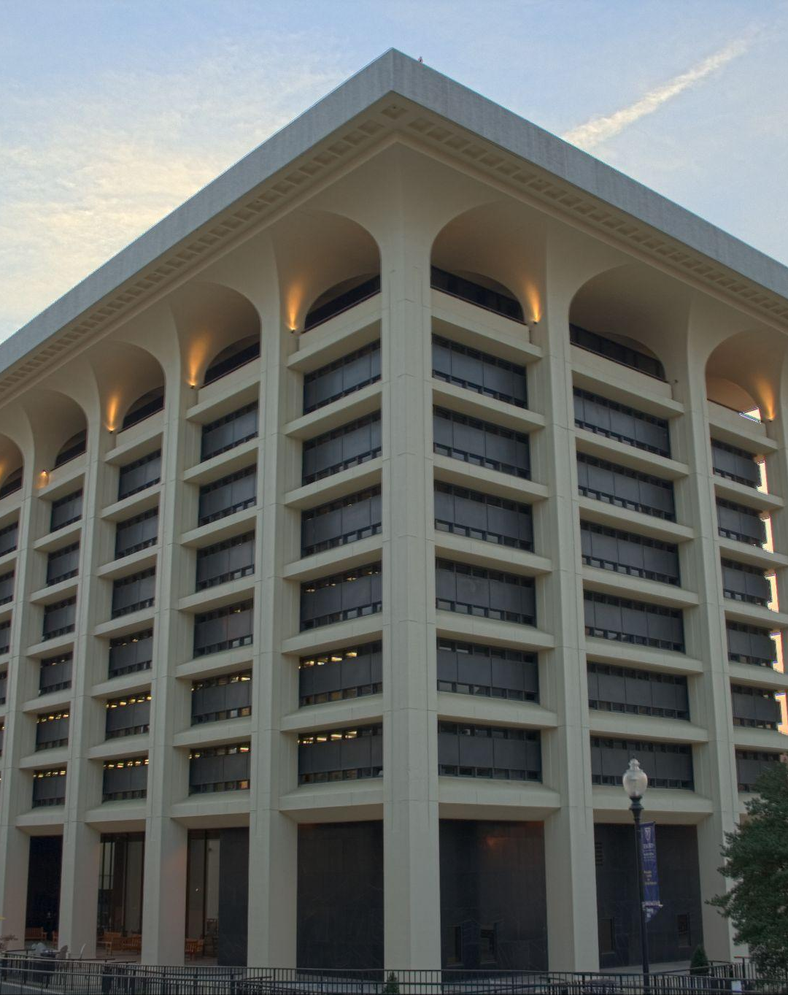
Stuart A. Rose Manuscript, Archives, and Rare Book Library
10th floor
Woodruff Library

Slide 5
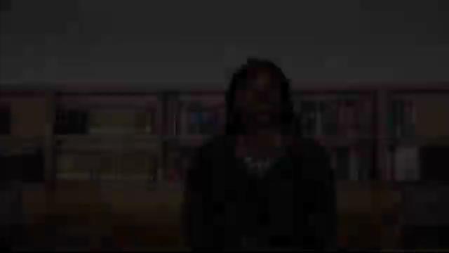

Slide 6
Collection Strengths
1
African American History and Culture
2
Emory University Archives
3
Literature and Poetry
4
Political, Social, Cultural Movements
5
Rare Books

Slide 7
1
Rationale
Why use archives in your class?

Slide 8
Why use the archives in your class?
Hands-on, experiential learning
Illustrates writing process
Primary source research
Visual analysis
Material culture
Alternative classroom experience
Research-based writing: BEAM

Slide 9
Joseph Bizup: BEAM Framework
B
E
A
M
Background
Evidence
Argument
Method
Providing general information on topic
Analyzing data, quotations, or examples
Agreeing or disagreeing with a source
Applying a way of arguing to your own issue
Notes:
Citation: Bizup, Joseph. “BEAM: A Rhetorical Vocabulary for Teaching Research-Based Writing.” Rhetoric Review 27.1 (2008): 72-86. Communication & Mass Media Complete. Web. 4 February 2014.

Slide 10
2
Resources
How to get started and where to find help

Slide 11
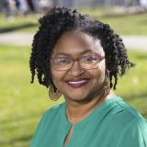
Resources
Staff
Request Form
Assignment Portal
Jacqueline Reed
Instruction Coordinator
jacqueline.reed@emory.edu
Complete an intake form to begin the process for a class visit
Access here
Repository of successful archival assignments
Access here

Slide 12
3
Ideas
Possible class sessions and assignments

Slide 13
Class Sessions
Speed Dating
Treasure Hunt
Students rotate around a set of objects
Students sift through a set of materials to address a question or topic
Group Work
Individual Research
Groups of 2-4, students explore materials and present their findings to the class
Students act like scholars in the reading room with their own set of materials

Slide 14
Assignments
Options for in-class or semester-long writing projects
More ideas available on the Assignment Portal
In-class
Post
Analysis
Exhibitions
Worksheets exploring artifacts
Discussion or blog post reflecting on archival visit
Textual or visual analysis paper
Curating mock, digital, or physical exhibition

Slide 15
4
Examples
Successful archival classwork by Emory undergraduates across the curriculum
.

Slide 16
Examples
ENG 101
SOC 489
Expository Writing: Writing about Travel
Moon Bound: A Sociology of the Apollo Era

Slide 17
“I watched students light up when permitted to look at objects and documents which the archivists have selected for their viewing… The Rose Library and the instructional sessions inspire me and my students equally!”
-Anna Leo

Slide 18
Thanks!
See you in the archive!
www.sarahharsh.com
Please keep this slide for attribution

