Slide 1
The First-Year Seminar: Orality, Ethics, and Student Learning
John Duffy
University of Notre Dame

Slide 2
The Plan
1. Introductions
2. What Do We Mean by Oral Skills?
3. Why Teach Oral Skills?
4. How Do We Teach Oral Skills?
5. How Do We Assess Oral Skills?
6. Group Activities
7. Wrapping Up

Slide 3
Defining Terms: What Do We Mean by Oral Skills?
Discussion
Debate
Presentation
Public Address

Slide 4
Discussion & Debate
Discussion
Informal or formal, unstructured or structured, dyadic or group
Characterized by “reciprocity and movement, exchange and inquiry, cooperation and collaboration
“ .. .. disciplined or concerted talk” in which participants work together to address a question, issue, or problem” (Bridges, in Brookfield & Preskill (5)
Debate
Informal or formal, unstructured or structured
Characterized by research, writing, fact-based, persuasive & orderly exchange of views
“I want to make sure people are at least hearing each other. Finding common ground is not the point, but common ground may be exposed.” (John Donvan, Open Debate Project)

Slide 5
Presentation & Public Address
Presentation
Communication of information to an audience by an individual or group
Characterized by research, writing, organization, visual aids, question and answer period
Public Address
Spontaneous or rehearsed; persuasive or informational
Characterized by the interaction of situation, speaker, audience, message
“There are only two types of speakers in the world. 1. The nervous and 2. Liars” (Mark Twain)
WHICH FORM[S] OF ORAL SKILLS WILL YOU TEACH YOUR STUDENTS?

Slide 6
Why Teach Oral Skills?
Develops qualities open-mindedness, intellectual flexibility & agility
Encourages attentive listening
Discourages dogmatism
Promotes practices of ethical communication
Foundational to democracy
It’s fun!

Slide 7
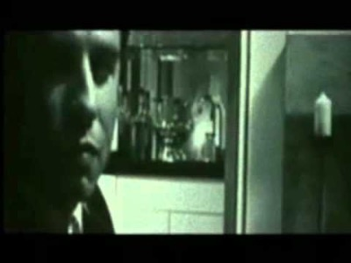
Listen or Wait To Talk?

Slide 8
Ethics and Oral Skills
Talk implies relationships. What qualities enable relationships to thrive?
Credibility: Truthfulness, Knowledge, Respectfulness
Evidence: Accountability, Integrity
Counterarguments: Humility, Generosity, Intellectual Courage
What qualities break relationships?

Slide 9
Democratic Discussion
Receptivity to new ideas & perspectives
Participation as a means of learning
Deliberativeness & collaboration
Acceptance of dissensus
(Source: Brookfield & Preskill, 1-21)

Slide 10
How To Teach Oral Skills? Responding to Readings (1)
Study Questions
Give students study questions in advance and ask for written pre-responses (in email form or in a blog, for example) that the entire class can read before the discussion session. Or, if selecting students to lead the discussion, ask them to prepare study questions and send them to you for previewing before they are disseminated to the whole class.
Students as Experts
Break-down the text and assign particular difficult parts to specific students who are going to be the designated expert interpreters. They formulate answers to questions such as: “What does this add to what we have learned already?” or “How do we use this ‘language’ to talk about the overarching questions/themes of the class?”
Critics’ Argument
Give the students two divergent critical analyses of the text by different authors and ask them to take sides, put their chosen critic’s view in their own words, and explain why they favor one view over the other.

Slide 11
How To Teach Oral Skills? Responding to Readings (2)
Role Playing
Students create short sketches in which they act out different perspectives on a theme or opposing positions in an argument. Students can also write and perform dialogues between thinkers/authors (Aristotle and Plato, Dante and Shakespeare, MLK & Malcolm X), characters from different novels or plays (Ophelia, Jane Austen, and Stephen Dedalus), etc. You can set parameters in terms of what the sketches must cover. For example, give students a list of themes, topics, etc. they are supposed to cover.
Multi-Media Pairings
Pair a text with a film, a piece of music, an image, a performance, and ask students to imagine how one medium can serve as an illustration or critical analysis of the other. Better not to choose adaptations of the text into other media but instead to purposefully pair the written text with visual/aural texts on seemingly unrelated subjects. For example, when discussing a reading on the topic of human rights, avoid screening a documentary on human rights but rather choose a conventional narrative film or an art film

Slide 12
How To Teach Oral Skills? Discussion Activities
Think-Pair-Share
Round Robin
Fishbowl
Conversational Roles
Debates
Public Address

Slide 13
Teaching Tips
Be Prepared
Be Mindful
Be Flexible
Be Meta

Slide 14
Assessing OrAl Skills
Faculty Interviews
Student Self Assessment
Faculty Assessment
Ungrading

Slide 15
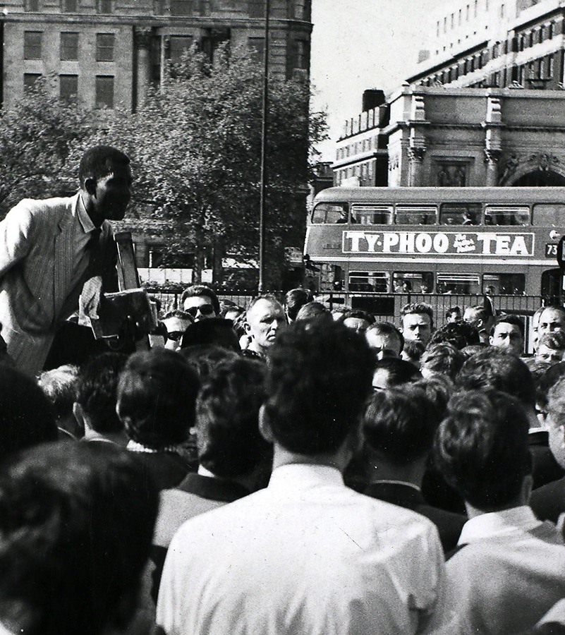
The End!
For further reading: See Handout #7

