Slide 1
Composing Posters: Visualizing Research and Data
Megan Cole, Biology
David Fisher, Writing Program

Slide 2
Conceiving the assignment
Emory College of Arts and Sciences: Administration. (n.d.). Retrieved April 1, 2018, from http://college.emory.edu/main/administration/index.html

Slide 3
Why a Poster
Desire to innovate (move beyond the essay)
Focus on transferrable knowledge and skills
Availability of electronic resources – For producing poster and for providing feedback
Approximate expert “stancetaking”
Students make essential rhetorical moves in fewer words (feedback load)
Scalable in pieces
Multimodal design and delivery
Leedham, M. (2009). From traditional essay to ‘Ready Steady Cook’ presentation: Reasons for innovative changes in assignments. Active Learning in Higher Education, 10(3), 191–206.

Slide 4
Posters in Intro Biology lab (BIOL 141L)
Motivation:
Wanted to have individual students present their own research in written scientific format
Previously students wrote scientific papers ~10pages
This was time-intensive for students and instructors
Limited the number of drafts and assignments we could do in a semester
Common issues with writing would be revealed in format of a poster
Gaps in logical reasoning
Issues creating/analyzing graphs
Grammar issues & misuse of jargon
Wrong writing style

Slide 5
Posters in Intro Biology lab (BIOL 141L)
Scientific Poster Assignment
Create an electronic poster (using PowerPoint or another program) of your [research project].
Requirements:
Posters must include the following sections (note that an abstract is not included):
Title & author list
Introduction & Background Information
must include at least 2 primary scientific article references
Materials & Methods
must be written using passive voice in full paragraphs
Results
must include at least 1 figure with caption
Discussion/Conclusions
Format…
Honor code…
Helpful Resources…

Slide 6
Poster ecology
Draft of research article / Conference proposal or abstract
Handout for readers interested in detailed results
Narrative descriptions
Research objectives and main findings
Elements of the poster
Background
Key studies and gaps in existing literature
Data and methods
Each table chart or set of bulleted results
Research, policy, and practice implications
Questions to ask viewers
Soliciting input about findings
Developing additional questions for later findings
Identifying other researchers in the field
Miller, J. E. (2007). Preparing and Presenting Effective Research Posters. Health Services Research, 42(1), 311–328. https://doi.org/10.1111/j.1475-6773.2006.00588.x

Slide 7
Your turn
For what course are you thinking about developing a poster assignment?
Why are you interested in developing a poster assignment for this particular course?

Slide 8
Scaffolding the assignment
Emory College of Arts and Sciences: Administration. (n.d.). Retrieved April 1, 2018, from http://college.emory.edu/main/administration/index.html

Slide 9
Types of Scaffolding
Breaking task into smaller, more manageable parts
Verbalizing thinking processes in tasks
Cooperative learning
Concrete prompts
Questioning
Providing instructions and/or tips, strategies, cues, procedures
Coaching
Modeling
Activation of previous knowledge
Lipscomb, Lindsay; Janet Swanson; and Anne West. “Scaffolding.”

Slide 10
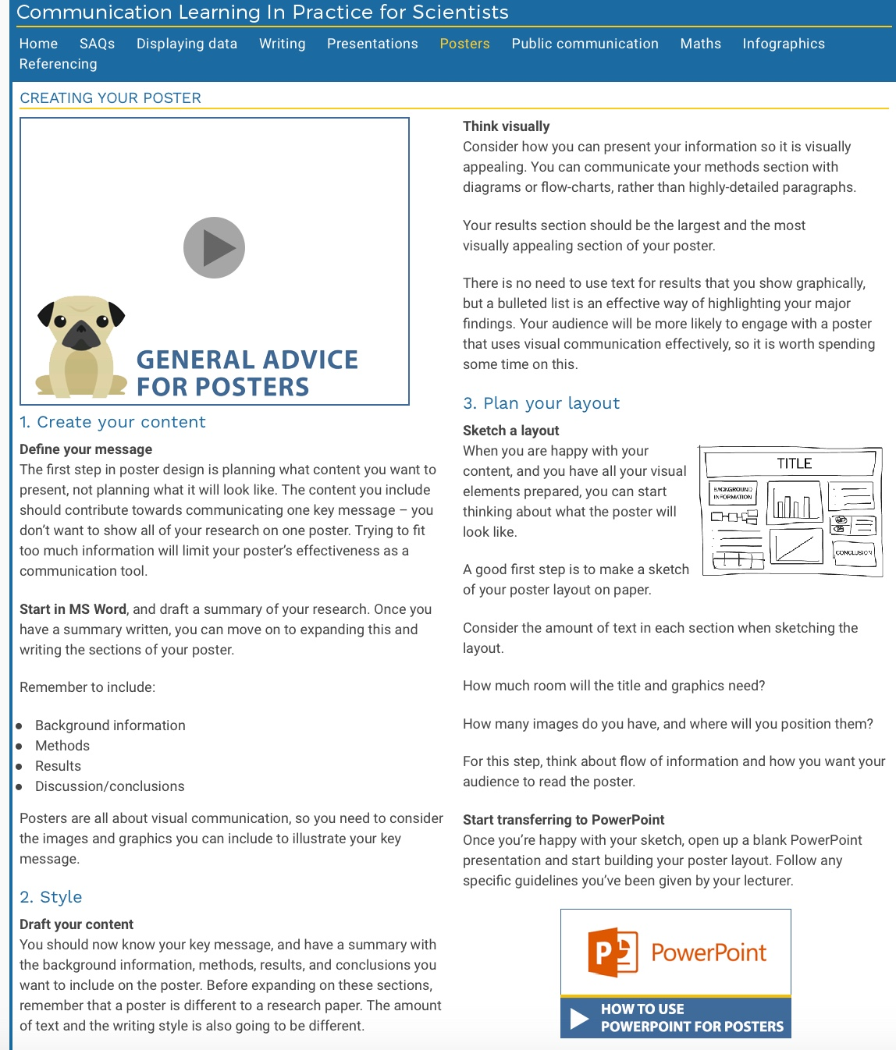
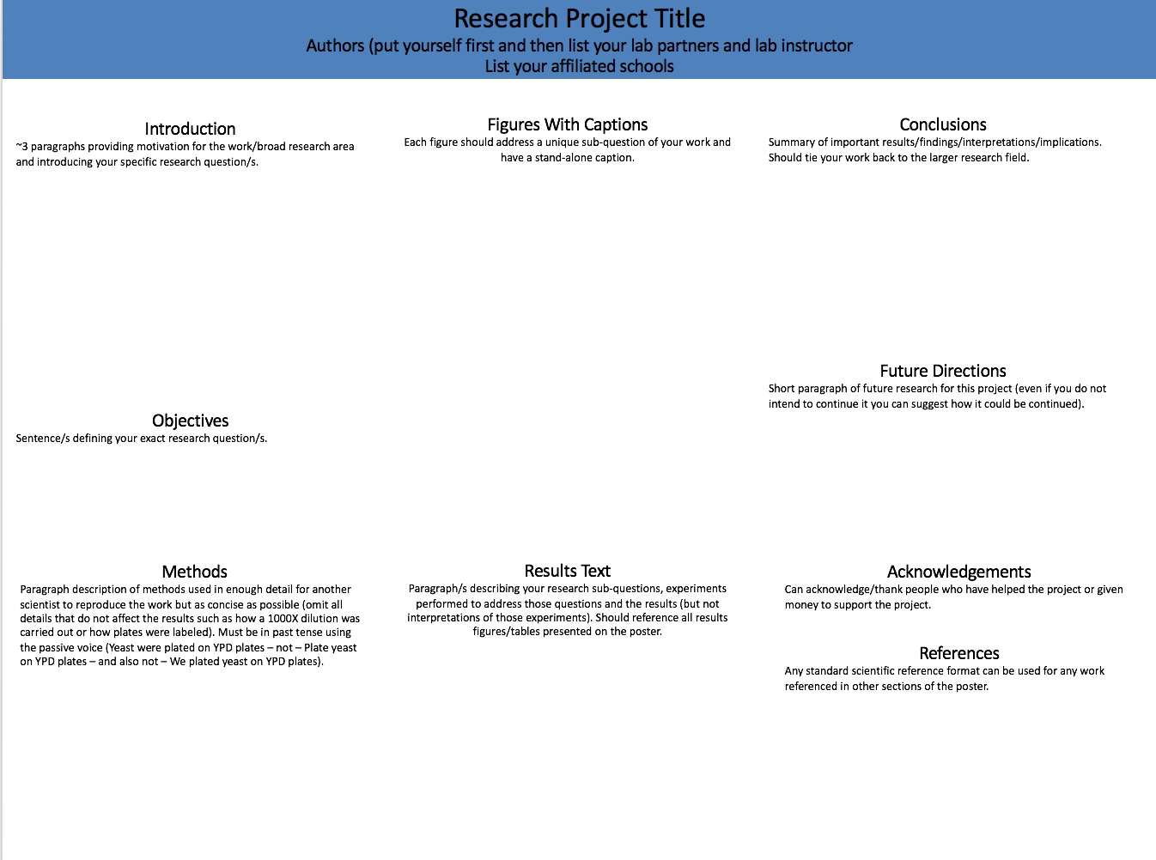
Scaffolding Posters in Biology 141
Resources
http://www.clips.edu.au/posters/
Creating a research space
Poster template file
Grading rubric
Videos on finding & reading primary literature

Slide 11
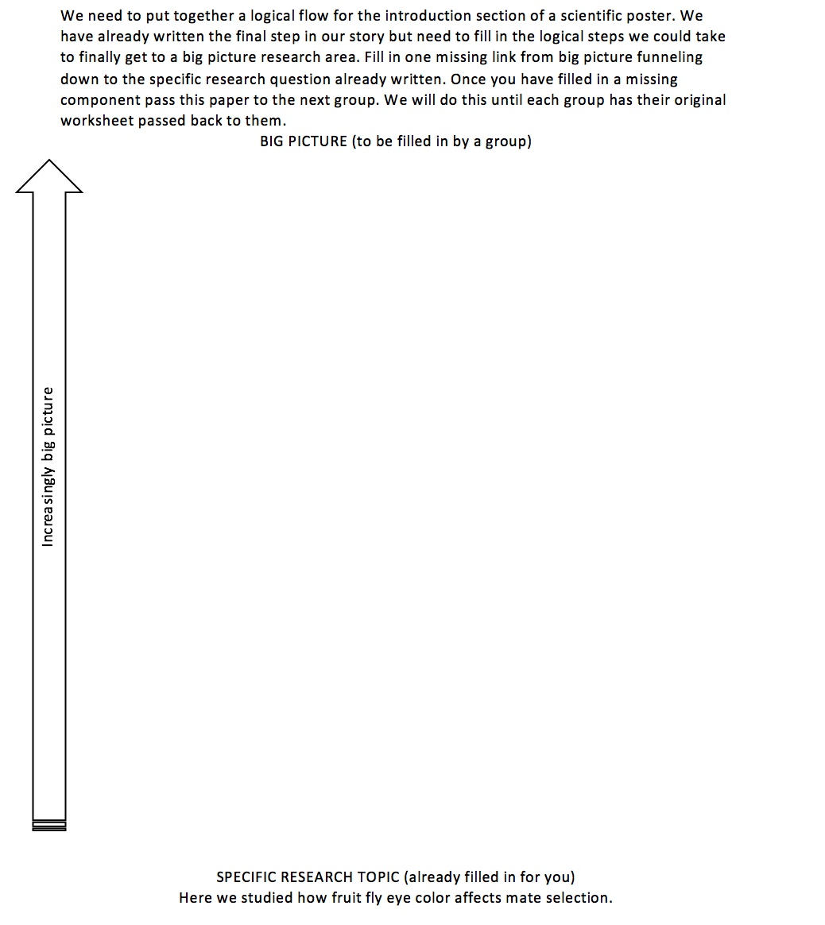
Scaffolding Posters in Biology 141
In-lab worksheets
Introduction funnel
Methods section round robin
Making graphs
Mock poster outline
Poster outline assignment

Slide 12
Scaffolding Posters in Biology 141
Scaffolded assignments
Poster Review
Poster Outline
Graph
Draft Poster
Group Poster
2 Poster projects

Slide 13
Your turn
How might you scaffold a poster assignment in your course? What would come first? Middle? Last?
How might work on parts of the poster parallel the readings, lecture, and other activities taking place in class during the period when students are composing?

Slide 14
Assessing the assignment
Emory College of Arts and Sciences: Administration. (n.d.). Retrieved April 1, 2018, from http://college.emory.edu/main/administration/index.html

Slide 15
Assessing Posters in Biology 141
Concerns | Criteria (possible pts) | Advanced | Pts
 | Poster follows formatting and organization outlined in the instructions and is visually appealing. 3pts
 | Poster provides strong motivation for the work and ties it to a larger research question. 2pts
 | Clearly lays out the background knowledge needed. 2pts
 | Clearly defines specific research question 1pt
 | Accurately and unambiguously describes research methods for experiments presented in the poster. 3pts
 | Results text summarizes main purpose and findings of each figure. 2pts
 | Appropriate graphical representations of data. 3pts
 | Clearly summarizes main conclusions. 2pts
 | References relevant literature, and ties it into the research project. 2pts

Slide 16
Tools
Use tools and colors consistently for different types of comments.
Science (comment tool, yellow)
Writing/logic (blue insertions/deletions)
Grammar (yellow highlight)
Design (red pencil and textbox)

Slide 17
Learning as we write: Translating
Numeric patterns and contrasts
Number of enrolled children in the family is correlated with disenrollment.
The log-hazard of disenrollment for one-child families was 0.316.
Families with only one child enrolled in the program were about 1.4 times as likely as larger families to disenroll.
Miller, J. E. (2007). Preparing and Presenting Effective Research Posters. Health Services Research, 42(1), 311–328. https://doi.org/10.1111/j.1475-6773.2006.00588.x
Notes:
As you describe patterns or numeric contrasts, whether from simple calculations or complex statistical models, explain both the direction and magnitude of the association. Incorporate the concepts under study and the units of measurement rather than simply reporting coefficients (betas).
Comment 1: Neither the direction nor the size of the association is apparent.
Comment 2: Most readers find it easier to assess the size and direction from hazards ratios (a form of relative risk) instead of log-hazards (log-relative risks, the betas from a hazards model).
Comment 3: This version explains the association between number of children and disenrollment without requiring viewers to exponentiate the log-hazard in their heads to assess the size and direction of that association. It also explicitly identifies the group against which one-child families are compared in the model.

Slide 18
Design
Important information should be legible from about 10 feet away.
Title is short and draws interest.
Word count of about 300 to 800 words.
Text is clear and to the point.
Use of bullets, numbering, and headlines make it easy to read.
Effective use of graphics, color, and fonts.
Consistent and clean layout.

Slide 19
Design
C - color and contrast
R - repetition
A - alignment
P - proximity and placement
Notes:
The following slides provide an overview of these properties by forcing us to do what’s called a “squint test.”

Slide 20
Contrast and Color
Significant contrast between the background colors and text.
If the elements (type, color, size, line thickness, shape, space, etc.) are not the same, then they should be very different.
Contrast is often the most important visual attraction on a page.

Slide 21
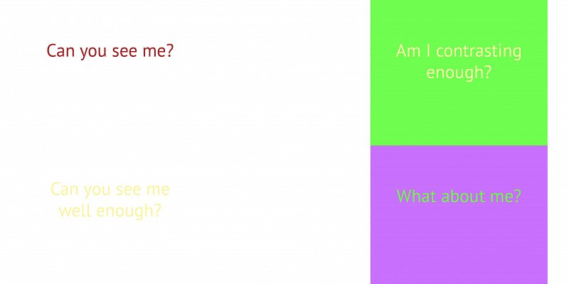
Contrast for Contrast’s Sake
Yellow on white is hard to read
Notes:
This attracts attention but tires out the eye

Slide 22
Figure Clarity
Tufte, E. (2001). The Visual Display of Quantitative Information (2nd ed.). Cheshire, Conn.: Graphics Press.
Notes:
Tufte. Edward
Data-ink is the non-erasable core of a graphic, the non-redundant ink arranged in response to variation in the numbers represented.

Slide 23
Photo Resolution
Notes:
Avoid resolution overkill! At least 150 dpi, but no more than 300 dpi
Save photos as jpg or png
Line art as a png (graphs)
Web images are usually poor resolution

Slide 24
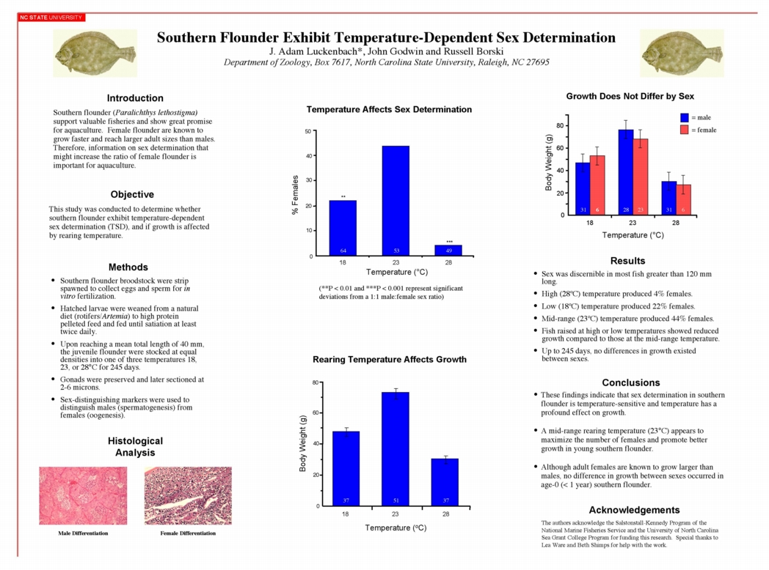
Repetition
Well chosen palette of a few of colors (3-4 max), fonts (2-3, including bolding and italicizing), and font sizes (2-3 max).
Visual elements of the design repeated throughout the piece: color, shape, texture, spatial relationships, line thicknesses, sizes.
Repetition develops organization and strengthens unity.
Notes:
Avoid redundancy (i.e., bulleting every paragraph on poster).

Slide 25
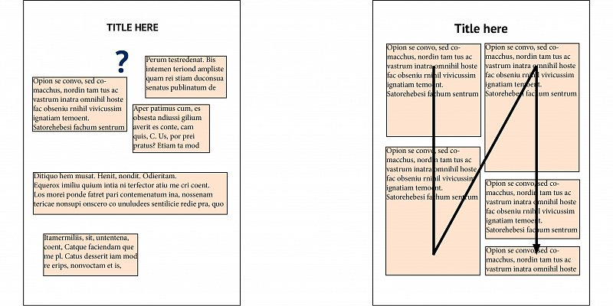
Alignment
Strong alignment creates visual cohesiveness, order out of chaos.
Nothing placed on the page arbitrarily. Every element has some visual connection with another element on the page.
Visual connections help create a clean, sophisticated, fresh look.

Slide 26
Proximity and Placement
Arrangement and spacing of elements reveals their relationship to one another.
Items relating to each other should be grouped close together. When several items are in close proximity to each other, they become one visual unit rather than several separate units.
Proximity helps organize information and reduces clutter.

Slide 27
Your turn
What are the learning outcomes for the poster assignment you’re contemplating? In other words, what do you want students to know and be able to do after working with this genre?
How do you plan to communicate those expectations to students at the outset of the project, provide formative feedback during the project, and assign a grade at the conclusion of the project?

Slide 28
Sources
Cornell Center for Materials Research - An NSF MRSEC. (n.d.). Retrieved March 21, 2016, from http://hsp.berkeley.edu/sites/default/files/ScientificPosters.pdf
Creating a Research Poster in Photoshop. (n.d.). Retrieved March 21, 2016, from https://www.wellesley.edu/lts/techsupport/projects/plotterprinting/creating-research-poster-photoshop/node/40502
Bawarshi, A. (2001) The Ecology of Genre. Ecocomposition: Theoretical and Pedagogical Approaches. Eds. Sidney I. Dobrin and Christian R. Weisser. New York: State University of New York Press. 69-80.
D’Angelo, L. (2010). Creating a Framework for the Analysis of Academic Posters. Language Studies Working Papers, 2, 38–50.
Emory College of Arts and Sciences: Administration. (n.d.). Retrieved April 1, 2018, from http://college.emory.edu/main/administration/index.html
Fadeyev, D. (2012, September 7). Rags Over Rivers - The Usability Post. Retrieved March 24, 2016, from http://usabilitypost.com/2012/09/07/rags-over-rivers/
Guerra, D. (n.d.). DesigingScientific Posters: EAST Tips for Researchers. Retrieved March 21, 2016, from http://www.diogoguerra.com/essays/2014/09/designing-scientific-posters-easy-tips-for-researchers/
Leedham, M. (2009). From traditional essay to ‘Ready Steady Cook’ presentation: Reasons for innovative changes in assignments. Active Learning in Higher Education, 10(3), 191–206. https://doi.org/10.1177/1469787409343187
Melzer, D. (2014). Assignments across the curriculum: A national study of college writing. Boulder, Colorado: Utah State University Press.
Miller, J. E. (2007). Preparing and Presenting Effective Research Posters. Health Services Research, 42(1), 311–328. https://doi.org/10.1111/j.1475-6773.2006.00588.x
Purdue OWL: Writing Scientific Abstracts Presentation. (n.d.). Retrieved March 21, 2016, from https://owl.english.purdue.edu/owl/resource/706/1/
Scocco, D. (n.d.). C.R.A.P.:The Four Principles of Sound Design. Retrieved March 21, 2016, from http://www.dailyblogtips.com/crapthe-four-principles-of-sound-design/
Spinuzzi, C. (2002). Modeling Genre Ecologies. In Proceedings of the 20th Annual International Conference on Computer Documentation (pp. 200–207). New York, NY, USA: ACM. https://doi.org/10.1145/584955.584985
Soliday, M. (2011). Everyday Genres: Writing Assignments across the Disciplines. Carbondale: Southern Illinois University Press.

