Slide 1
Writing, Student Memory, and Performance
********************************************
Writing across Emory Program
Led by Andy Kazama (Psychology, Developmental Cognitive Neuroscience)
and Joonna Trapp (Writing Program, English)
22 March 2017

Slide 2
Today’s Roadmap
Places around Emory
  Introduction: Gates at Emory
    What are students coming in with?
    What are YOU coming in with?
  WoodPec Athletic Center (track)
    Physiology of Learning & Memory
  Library
    Retention Techniques
  Schwartz Center for the Arts
    Performance Time
    How you work this into your actual classrooms
  Slice & Pint
    Discussion

Slide 3
Today’s Roadmap

Slide 4

Entrance Gates to Emory
ENTRY
MUSEUM
LIBRARY
STAGE
P.E.
BEER
What retention methods are students bringing in?
  Study Guides
  Rote Memorization
  Poor Time Management
  Multi-tasking
What retention methods are you bringing in?
Notes:
Exercise: What retention tools are you bringing in? Hopefully, by the end we can make those tools even more effective.

Slide 5
Today’s Roadmap

Slide 6
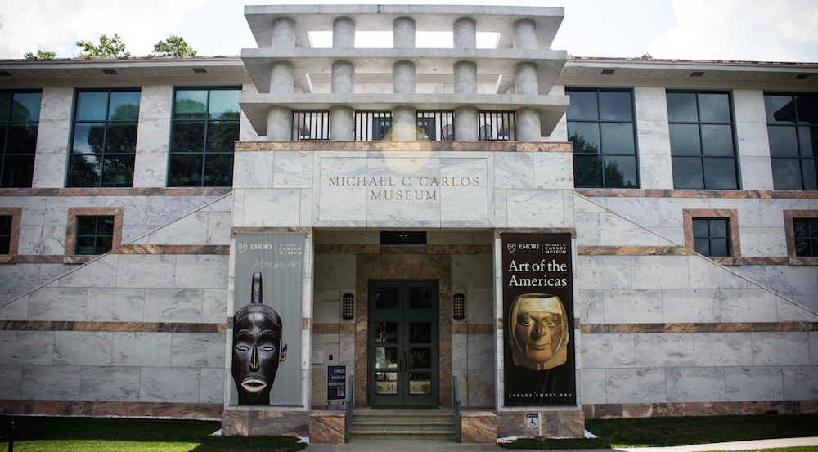
Carlos Museum
ENTRY
MUSEUM
LIBRARY
STAGE
P.E.
BEER
HISTORY OF MEMORY FROM ANCIENT GREECE
ELABORATIVE ENCODING

Slide 7
The Art of Memory in the Ancient World:
ENTRY
MUSEUM
LIBRARY
STAGE
P.E.
BEER
Simonides:
Plato: A mental art though which we access the recollection of the ideal, the divine
Cicero: part of the virtue of prudence (worked with intelligence and providence)
Notes:
Story of Simonides
Most likely created Artificial memory training
According to Cicero (De Oratore II lxxxvi 354), Simonides taught that the orator selects locations where he stores images in a kind of spatial arrangement…thus the order of arguing is readily available at any one time
(Our expression, “in the first place” may arise from this)
A street or town or house were favorite locations to use for this.

Slide 8
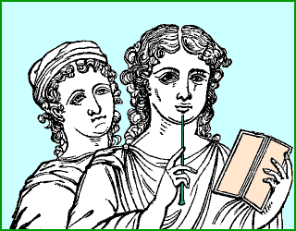
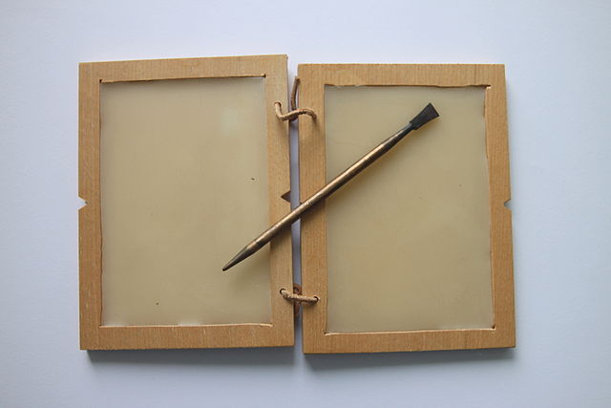
“Inscribing letters on wax”—description of good memory—De Oratore II (Lxxxvii.360)
ENTRY
MUSEUM
LIBRARY
STAGE
P.E.
BEER
From a picture found in Herculaneum (Mus. Borbon. vol. VI tav. 35). Article by William Ramsey http://penelope.uchicago.edu/Thayer/E/Roman/Texts/secondary/SMIGRA*/Stilus.html
By Peter van der Sluijs - Own work, CC BY-SA 3.0, https://commons.wikimedia.org/w/index.php?curid=26045982

Slide 9
Two Parts of Memory
ENTRY
MUSEUM
LIBRARY
STAGE
P.E.
BEER
Natural
each individual has set quantity, what we exhibit when called upon to recall information
Artificial (made—”artifice”)
trainable, teachable with practice--many mnemonic strategies—has organized data into orderly set of memory places for easy retrieval
Notes:
Memory was not just system of recollection—also a means of invention. Cicero would sequester himself when faced with hard court case, then call his now famous scribe, Tiro, who many credit with the invention of short-hand would take dictation of his speech he had often composed in his head with his prodigious memory. Writing supplies were expensive, so composition often occurred in the head before writing the finalized copy. For Cicero, the training of his memory provided him ready invention tools for impromtu speeches in the senate.

Slide 10
Aristotle’s Memory system
ENTRY
MUSEUM
LIBRARY
STAGE
P.E.
BEER
Memorize good stock of definitions
Memorize stock of premises for the development of arguments—these are called “commonplaces” (note “places”)—things held in common by a group of people that they agree upon
Urged development of an identifying word for each and arrangement by number or alphabet so that one would lead to the other
Speech-making grounded in beliefs and accepted values and systematic arrangement

Slide 11

Memory as Treasure-House!
ENTRY
MUSEUM
LIBRARY
STAGE
P.E.
BEER
Quintillian believed developing the memory was a teachable art. Memory is
“the treasure-house of the ideas supplied by Invention”
Values Stories
Ideas Examples
Beliefs Histories
Community Futures
Culture Identity
Notes:
As a teacher, you must guide this storehouse building. Your department should be on the same page and use the learning already happening to build upon in your course. This is why general education is so challenging to teach—what is the foundation, treasure house, that you are building upon? It is the first step in college learning to get students to build their treasure house. Key courses are laid to provide opportunity—freshman seminar, first year writing, etc. Important to have people teaching those courses that “get” our college mission!

Slide 12
Today’s Roadmap

Slide 13
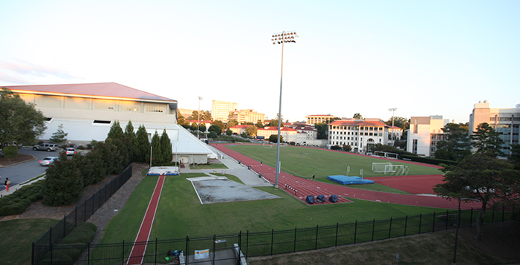
Woodruff P.E. Center
ENTRY
MUSEUM
LIBRARY
STAGE
P.E.
BEER
Name one academic activity/exercise.
What makes something “Unforgettable”?
NEUROBIOLOGY
  Long-Distance Running
  Emotional Memory
  1st Person Perspective
Notes:
Active Learning: Name one academic activity/exercise that has stuck with you from your undergraduate experience.
My memories: Alzheimer’s Clinic, Stopping to examine road kill with my vertebrate field zoology teacher, Mark Stanback

Slide 14
Today’s Roadmap

Slide 15
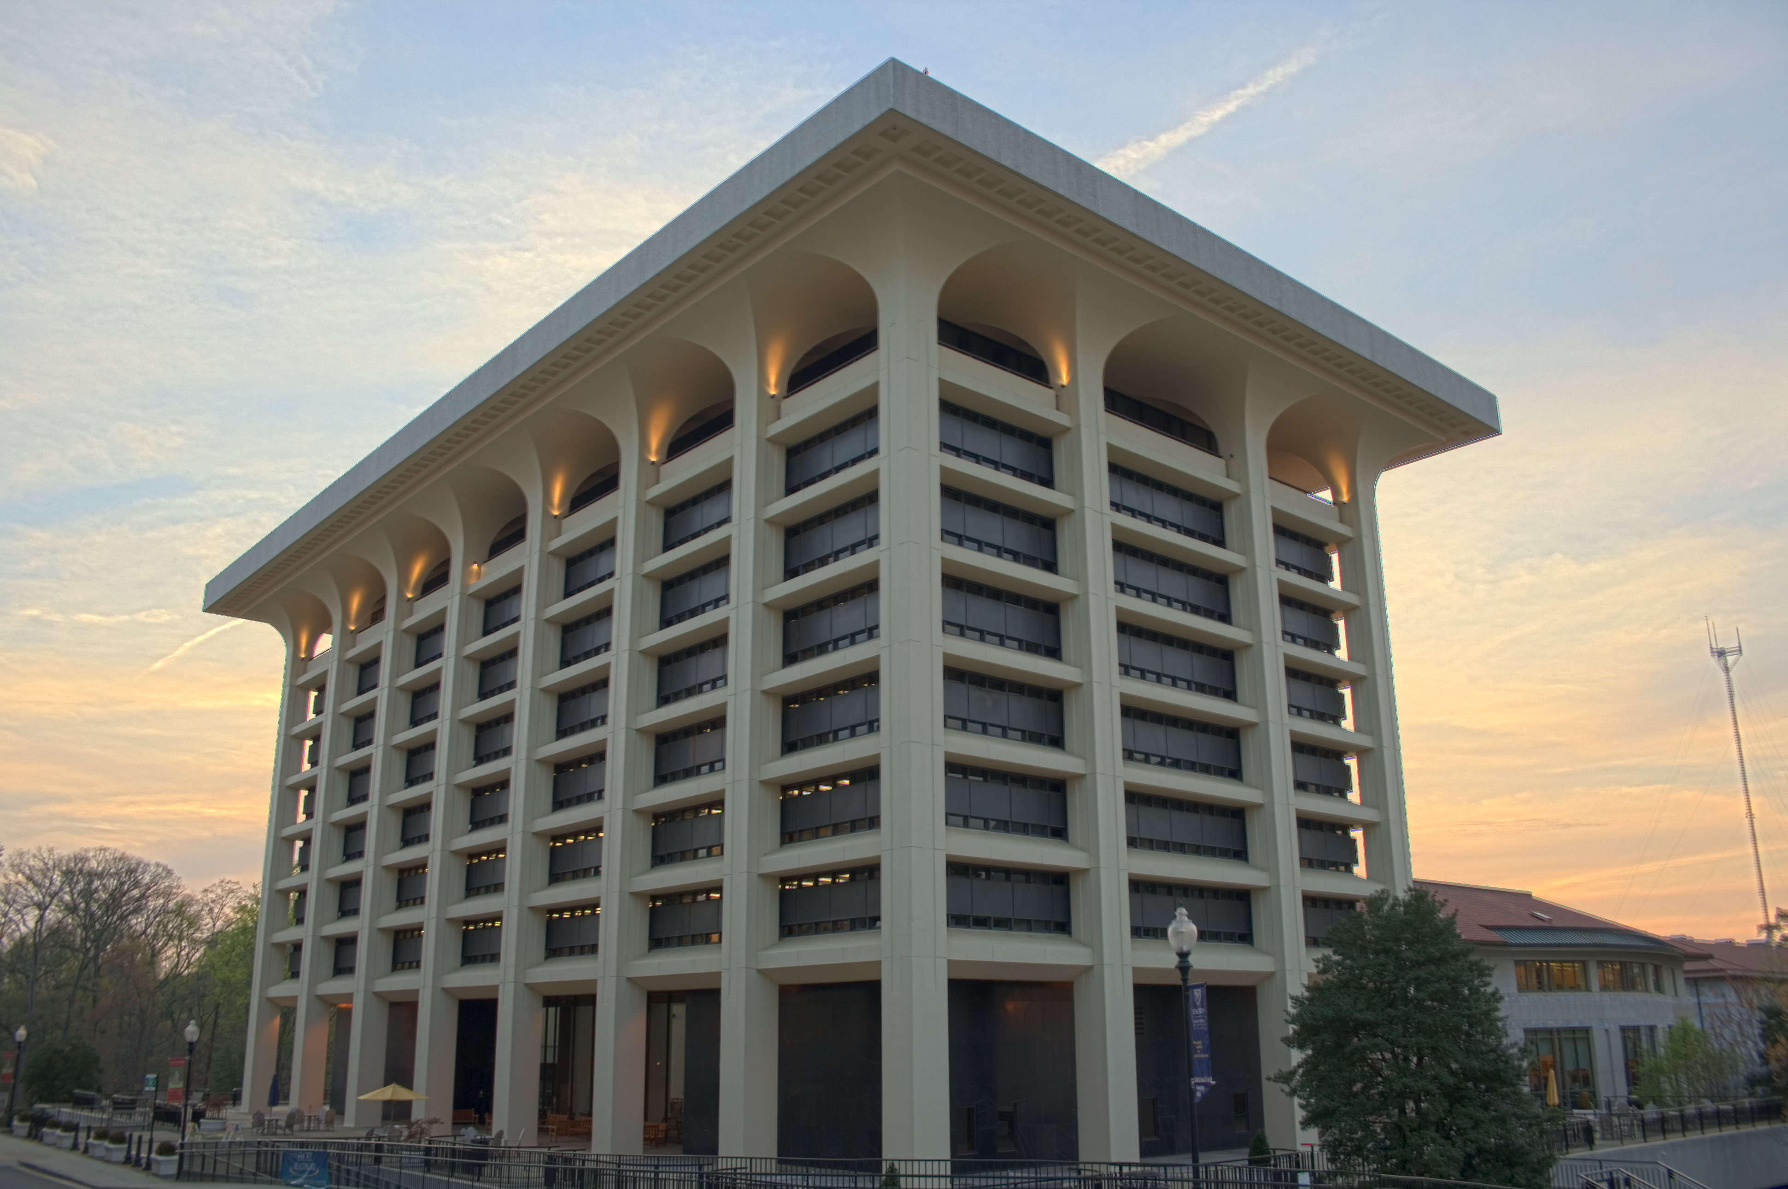
Woodruff Library
ENTRY
MUSEUM
LIBRARY
STAGE
P.E.
BEER
Elaborative Study Techniques
  Elaborative Encoding: A deeper level of retention involving larger neural networks
  Ex. songs, poems, drawings, stories, movie quotes, etc…
  Using the framework of Space
Review Schedule (Rule of 1/2s)
Importance of Maintenance
Notes:
MCM – Multi-Scale Contextual Model, Contextual Variability Theories, expanding interstudy interval and other jargon that will NOT help you implement practices that enable students to retain knowledge long-term…
Providing Students with Alternative Behaviors (Not Alternative facts…)
Building on what students are already doing. Ex. Flashcards with personal experiences built in, Writing Poems about Neuroscience, Neuroscience Song Lyrics.
Story about student who went from a 62% to 94% using rule of 1/2s (“representative case” ☺ )

Slide 16
Today’s Roadmap

Slide 17
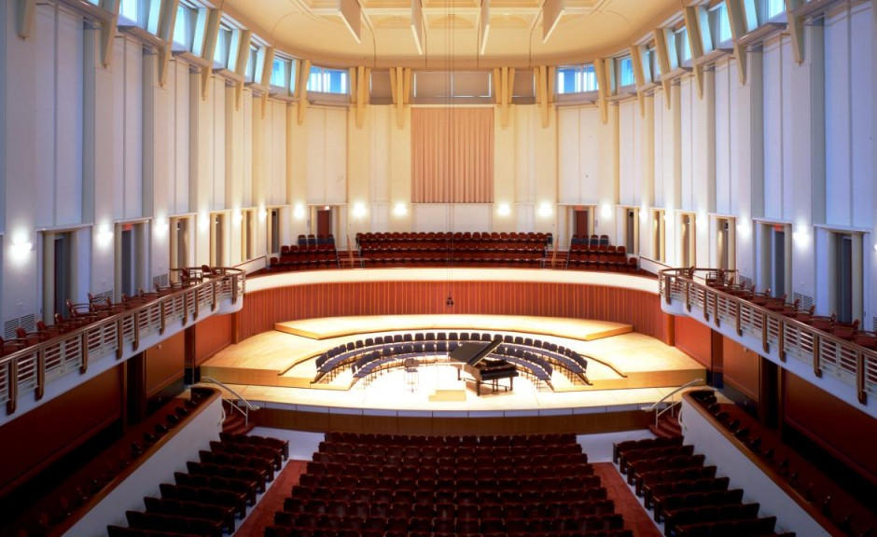
Schwartz Center for the Arts
ENTRY
MUSEUM
LIBRARY
STAGE
P.E.
BEER
How do you apply this in the classroom?
  Courage
  Ask yourself, “Would I remember this 10,20,30 yrs from now?”
  Mix between planning and Improv
Notes:
Student’s will forget your failures!

Slide 18

Why does this matter to teachers?
ENTRY
MUSEUM
LIBRARY
STAGE
P.E.
BEER
Rhetorical Theory teaches
us that literacy actually destroys
memory, that as we make room
for abstract thought, we
steadily decrease our ability to
use the memoria of the ancients.

Slide 19
Theatre’s Martin Carlson— “ghosting”
ENTRY
MUSEUM
LIBRARY
STAGE
P.E.
BEER
“[The] process of using the memory of previous encounters to understand and interpret encounters with new and somewhat different but apparently similar phenomena is fundamental to human cognition in general…. “
“. . . [G]hosting presents the identical thing that they [audience members] have encountered before, although now in a somewhat different context. (6-7)
Notes:
See notes on paper

Slide 20
Composition Theory
ENTRY
MUSEUM
LIBRARY
STAGE
P.E.
BEER
Thinking this way gives us a richer and more nuanced understanding of our pedagogies (and even of ourselves as teachers) by recognizing the presence of the past in our classrooms and in our lives.
We create “intertexts” in the classroom which are composed by the teacher, the text, the student, and all those who come along with the teacher, the text, and the student (ghosts)—all are collaborators.

Slide 21
Why does this matter to teachers?
ENTRY
MUSEUM
LIBRARY
STAGE
P.E.
BEER
We need to invite memoria, cultivate it, nurture it—way beyond delivery of information.
Creates culture, reshapes culture (personal, family, community, national, world)
Creates & shapes identity (all the above)
It is the business/heart of education—making citizens of all the above.

Slide 22
Space for Memoria—Inviting Memoria
ENTRY
MUSEUM
LIBRARY
STAGE
P.E.
BEER
Important Touchstones—9/11, Holocaust—hang learning on common shared events
Emory events—speakers, Coke Toast
Story—teacher, student, text
Examples—(ghosts of the past)
Experiences—physical, emotional
Values, beliefs, ideas—held in common—Key Terms
Sounds, rhythms, rhymes, visuals

Slide 23
Today’s Roadmap

Slide 24
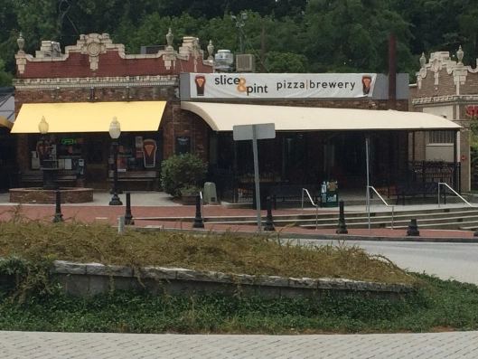
Slice & Pint
ENTRY
MUSEUM
LIBRARY
STAGE
P.E.
BEER
DISCUSSION

Slide 25
Take-Home Points
Many students are coming in with poor methods for retaining knowledge
Ancient Elaborative Encoding Methods are effective & supported by Modern Neuroscience
Providing guidance on how to write for retention may be as important as the material you teach.
Notes:
Read though.

Slide 26
Works Cited
Carlson, Marvin. The Haunted Stage: The Theatre as Memory Machine.Ann Arbor: U of Michigan P, 2001. Print.
Cicero. De Oratore. Books I-II. Trans. E. W. Sutton and H. Rackham. Loeb Classical Library. Cambridge, MA: Harvard UP, 1924. Revised 1948. Print.
Quintilian. The Institutio Oratoria of Quintilian. Trans. H.E. Butler. 4 vols. Loeb Classical Library. Cambridge: MA: Harvard UP, 1920-22. Print.
Trapp, Joonna, Paul Puccio, Keith Dorwick, and Bob Mayberry. “Remembering Ghosts, and the Rhetoric of Collaboration: A Play and Text for Teachers and Writers.” College Composition and Communication Online. January 2012. http://www.ncte.org/cccc/ccconline. Web.

Slide 27
Works cited
Cicero. Oratore. Trans. H. M. Hubbell. Loeb Classical Library. Cambride, MA: Harvard UP, 1971.
Aristotle. Rhetoric. Trans. John Henry Freese. Loeb Classical library. Cambridge, MA: Harvard UP, 1926.
Plato. The Collected Dialogues. Ed. Edith Hamilton and Huntington Cairns. Princeton, NJ: Printeton, UP, 1971.
Crowley, Sharon & Debra Hawhee. Ancient Rhetorics for Contempory Students. 5th Ed. NY: Pearson, 2012. “Delivery and Memory: Attending to Eyes and Ears, 325-345.
Kennedy, Tammie M. Reclaiming Memoria for Writing Pedagogies: Toward a Theory of Rhetorical Memory. Diss 2009.

